Slide 1
UPPER SIXTH ARTS
GEOGRAPHY
Lesson 19
Bid Rent and Functional Segregation
Notes:
Good morning, class, and welcome to our geography lesson. I am your geography teacher, Mr Kamdem. Today we are starting Lesson 19: Bid Rent and Functional Segregation.

Slide 2
CLASS INFO
Class, Chapter and Duration
Class | Upper Sixth Arts
Chapter | Module 5: Understanding and managing settlement dynamics across the world in general and Cameroon in particular
Duration | 2 periods (2 × 50 minutes)
Notes:
This lesson is for Upper Sixth Arts. It belongs to Module 5: Understanding and managing settlement dynamics across the world in general and Cameroon in particular. We shall need 2 periods to cover it.

Slide 3
IDENTIFICATION
Lesson Identification
Topic | Internal City Structure
Sub-topic | Internal City Structure
Lesson | Lesson 19: Bid Rent and Functional Segregation
Notions / Concepts | Bid rent, land value, accessibility, functional segregation, social segregation.
Syllabus focus | Bid rent theory: land value falling with distance from the CBD; bid rent curves; other factors (government, planning, relief, social segregation); effects on housing and activities.
Competence | Learners are able to explain land use zones in cities with bid rent theory.
Notes:
Our topic is Internal City Structure, and the sub-topic is Internal City Structure. The key notions we shall use today are: bid rent, land value, accessibility, functional segregation, social segregation. At the end, you should be able to do this: learners are able to explain land use zones in cities with bid rent theory.

Slide 4

HOMEWORK CORRECTION
Correction of the Homework
Question (Lesson 18: Structure of the City in MEDCs):
Draw a simple map of your town showing its zones and compare it with one model.
Notes:
Before we start the new lesson, let us correct the homework I gave you at the end of Lesson 18: Structure of the City in MEDCs. The question was: Draw a simple map of your town showing its zones and compare it with one model. Take out your exercise books.

Slide 5
HOMEWORK CORRECTION
Correction: Possible Answer
Example: the town has a central commercial area (market, banks), an old dense quarter, an administrative area, industrial zone near the river and new residential quarters on the edge – close to Hoyt's sector model along the main roads.
Notes:
Here is a good answer. Example: the town has a central commercial area (market, banks), an old dense quarter, an administrative area, industrial zone near the river and new residential quarters on the edge – close to Hoyt's sector model along the main roads. Compare it with your own answer and correct your work in red.

Slide 6
LESSON PLAN
Lesson Plan
Correction of the homework
Objectives and recall
Real-life situation and action to take
Learning activities
Board summary
Evaluation, remediation and homework
Notes:
Here is the plan of our lesson today. First, we shall correct the homework. Then we shall look at the objectives and recall what you already know. After that, we shall study a situation from real life and the action to take, and do the learning activities. Finally, we shall copy the board summary, do the evaluation and the remediation, and I will give you the homework.

Slide 7
OBJECTIVES
Objectives
By the end of this lesson, you should be able to:
Explain bid rent and land value.
Draw and read bid rent curves.
Explain other factors of segregation and their effects.
Notes:
By the end of this lesson, you should be able to do three things. Number 1: explain bid rent and land value. Number 2: draw and read bid rent curves. Number 3: explain other factors of segregation and their effects.

Slide 8
PREVIOUS KNOWLEDGE
Previous Knowledge
Land is expensive in the CBD.
Cities have zones.
Notes:
Let us first remember what you already know. Land is expensive in the CBD. Cities have zones. Keep this in mind, because we shall build on it today.

Slide 9
REAL-LIFE SITUATION
Situation in Real Life
In Douala, a small shop in Akwa pays a very high rent, while a large factory in Bassa pays less per square metre, and families find cheaper land far from the centre. Learners ask why.
Notes:
Listen carefully to this situation from real life. In Douala, a small shop in Akwa pays a very high rent, while a large factory in Bassa pays less per square metre, and families find cheaper land far from the centre. Learners ask why. Think about it, because I am going to ask you some questions.

Slide 10
REAL-LIFE SITUATION
Situation: Question 1
What is the problem in the situation?
Notes:
Question 1: What is the problem in the situation? Think for a moment, then raise your hand to answer.

Slide 11
REAL-LIFE SITUATION
Answer
Land prices change across the city.
Notes:
Good. Land prices change across the city.

Slide 12
REAL-LIFE SITUATION
Situation: Question 2
Where is land most expensive?
Notes:
Question 2: Where is land most expensive? Think for a moment, then raise your hand to answer.

Slide 13
REAL-LIFE SITUATION
Answer
In the centre, the most accessible place.
Notes:
Good. In the centre, the most accessible place.

Slide 14
REAL-LIFE SITUATION
Situation: Question 3
Which theory explains this?
Notes:
Question 3: Which theory explains this? Think for a moment, then raise your hand to answer.

Slide 15
REAL-LIFE SITUATION
Possible Answer
Bid rent theory.
Notes:
Good. Bid rent theory.

Slide 16
ACTION TO TAKE
Action to Take
Understand the urban land market and reduce segregation through planning.
Notes:
From this situation, the action we are working towards in this lesson is the following: understand the urban land market and reduce segregation through planning.

Slide 17
JUSTIFICATION
Justification of the Lesson
This lesson helps us to understand why activities occupy different parts of a city.
Notes:
Why is this lesson important for you? This lesson helps us to understand why activities occupy different parts of a city.

Slide 18
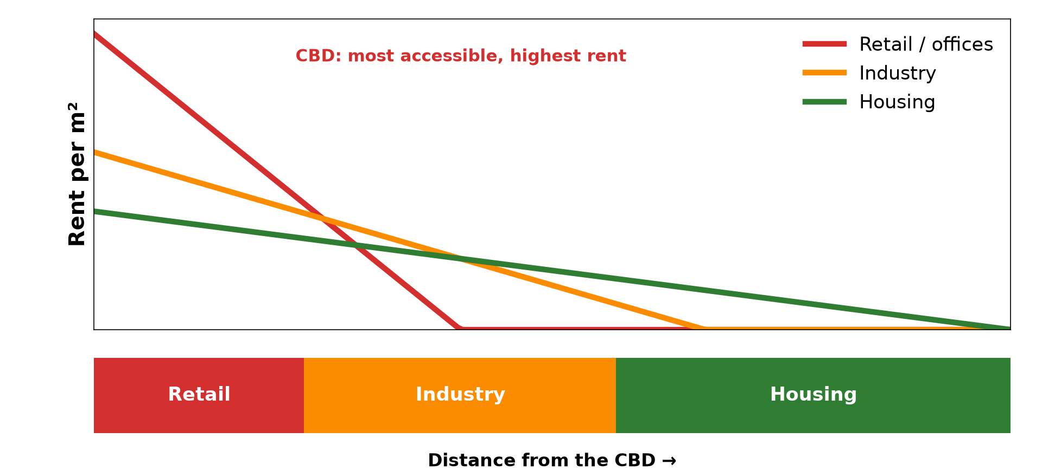
1. BID RENT THEORY
Activity 1
Bid rent curves.
Notes:
Activity 1. Look carefully at this diagram: bid rent curves. Observe every detail before I ask the question.

Slide 19
1. BID RENT THEORY
Activity 1: Question
Why can shops pay the highest rents in the CBD?
Notes:
Here is the question for Activity 1: Why can shops pay the highest rents in the CBD? Take one minute to think and write your answer in your rough notebook.

Slide 20
1. BID RENT THEORY
Activity 1: Answer
They need many customers, and the centre is most accessible.
Notes:
Let us check the answer together. They need many customers, and the centre is most accessible.

Slide 21

1. BID RENT THEORY
Activity 2
Tall buildings in the CBD.
Notes:
Activity 2. Look carefully at this picture: tall buildings in the CBD. Observe every detail before I ask the question.

Slide 22
1. BID RENT THEORY
Activity 2: Question
Why are buildings tall in the CBD?
Notes:
Here is the question for Activity 2: Why are buildings tall in the CBD? Take one minute to think and write your answer in your rough notebook.

Slide 23
1. BID RENT THEORY
Activity 2: Answer
Land is expensive, so owners build upwards.
Notes:
Let us check the answer together. Land is expensive, so owners build upwards.

Slide 24

2. SOCIAL SEGREGATION
Activity 3
A poor quarter.
Notes:
Activity 3. Look carefully at this picture: a poor quarter. Observe every detail before I ask the question.

Slide 25
2. SOCIAL SEGREGATION
Activity 3: Question
What is social segregation?
Notes:
Here is the question for Activity 3: What is social segregation? Take one minute to think and write your answer in your rough notebook.

Slide 26
2. SOCIAL SEGREGATION
Activity 3: Answer
The separation of rich and poor groups in different areas.
Notes:
Let us check the answer together. The separation of rich and poor groups in different areas.

Slide 27

2. OTHER FACTORS: RELIEF
Activity 4
A city in hilly relief.
Notes:
Activity 4. Look carefully at this picture: a city in hilly relief. Observe every detail before I ask the question.

Slide 28
2. OTHER FACTORS: RELIEF
Activity 4: Question
How can relief affect land use in a city?
Notes:
Here is the question for Activity 4: How can relief affect land use in a city? Take one minute to think and write your answer in your rough notebook.

Slide 29
2. OTHER FACTORS: RELIEF
Activity 4: Answer
Steep slopes and swamps are avoided or used by the poor.
Notes:
Let us check the answer together. Steep slopes and swamps are avoided or used by the poor.

Slide 30
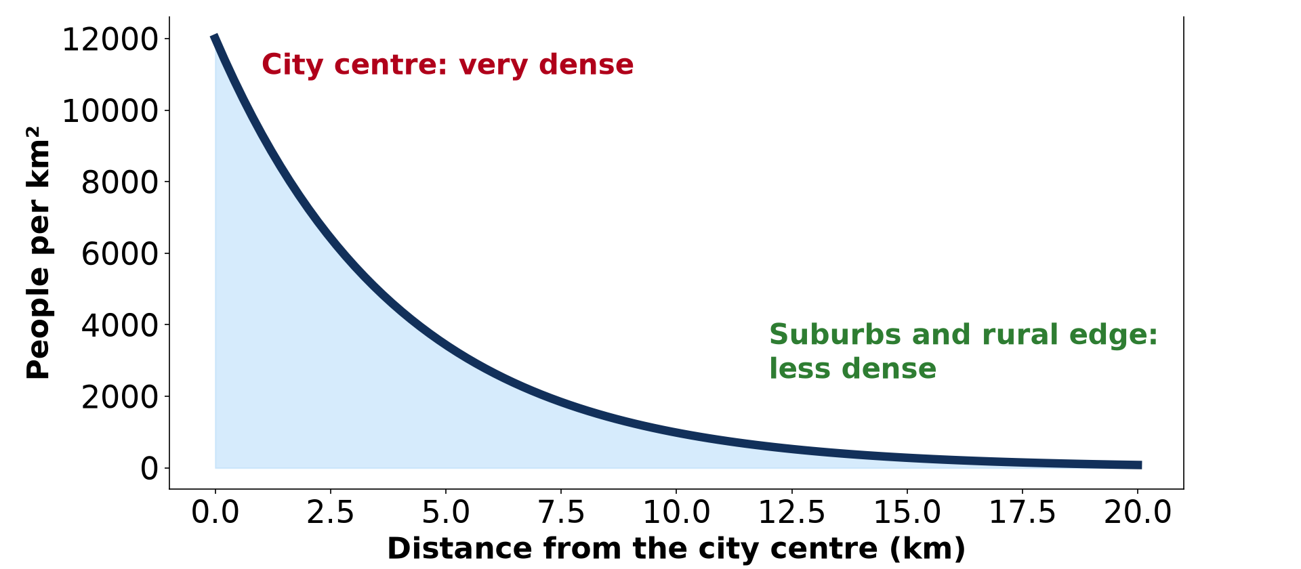
3. CONSEQUENCES
Activity 5
Density falls from the centre.
Notes:
Activity 5. Look carefully at this diagram: density falls from the centre. Observe every detail before I ask the question.

Slide 31
3. CONSEQUENCES
Activity 5: Question
How does bid rent affect population density?
Notes:
Here is the question for Activity 5: How does bid rent affect population density? Take one minute to think and write your answer in your rough notebook.

Slide 32
3. CONSEQUENCES
Activity 5: Answer
High rents near the centre lead to dense housing or flats.
Notes:
Let us check the answer together. High rents near the centre lead to dense housing or flats.

Slide 33
BOARD SUMMARY
Board Summary
Topic: Internal City Structure
Sub-topic: Internal City Structure
Lesson 19: Bid Rent and Functional Segregation
Notes:
Now we are going to copy the board summary. Write the title and the headings neatly in your notebooks. I will give you enough time for each slide, so do not rush.

Slide 34
BOARD SUMMARY
DEFINITIONS
The key terms of this lesson are defined as follows:
Bid rent: It is the amount that a land user is willing to pay for a site at a given distance from the centre.
Notes:
Let us copy the definitions. The key terms of this lesson are defined as follows. On this slide we have Bid rent. Write each point on a new line, with the key term first, and explain it in your own words when we revise. When you finish, we go to the next slide.

Slide 35
BOARD SUMMARY
DEFINITIONS (continued)
Functional segregation: It is the separation of different land uses into different zones of a town.
Notes:
We continue with the definitions. On this slide we have Functional segregation. Write each point on a new line, with the key term first, and explain it in your own words when we revise.

Slide 36
BOARD SUMMARY
1. The Bid Rent Theory
The urban land market works as follows:
Land value and accessibility: In a free market, land is most valuable at the most accessible point, the CBD. Locational rent decreases with distance from the CBD.
Notes:
Let us copy The Bid Rent Theory. The urban land market works as follows. On this slide we have Land value and accessibility. Write each point on a new line, with the key term first, and explain it in your own words when we revise. When you finish, we go to the next slide.

Slide 37
BOARD SUMMARY
1. The Bid Rent Theory (continued)
Bid rent curves: Shops and offices bid the highest rents near the centre, industry and flats next, and houses further out. Each land use occupies the zone where it bids highest.
Notes:
We continue with The Bid Rent Theory. On this slide we have Bid rent curves. Write each point on a new line, with the key term first, and explain it in your own words when we revise. When you finish, we go to the next slide.

Slide 38
BOARD SUMMARY
1. The Bid Rent Theory (continued)
Other zones: Secondary peaks of land value occur at road junctions and suburban shopping centres. Lower values are found in the fringe.
Notes:
We continue with The Bid Rent Theory. On this slide we have Other zones. Write each point on a new line, with the key term first, and explain it in your own words when we revise.

Slide 39
BOARD SUMMARY
1. The Bid Rent Theory
Illustration: bid rent curves
Notes:
Now draw this illustration in your notebook: bid rent curves. Give it a title and label it clearly.

Slide 40
BOARD SUMMARY
2. Other Factors of Segregation
Segregation also depends on:
Government and planning: Zoning laws separate residential, industrial and commercial areas. Public housing and roads change land values.
Notes:
Let us copy Other Factors of Segregation. Segregation also depends on. On this slide we have Government and planning. Write each point on a new line, with the key term first, and explain it in your own words when we revise. When you finish, we go to the next slide.

Slide 41
BOARD SUMMARY
2. Other Factors of Segregation (continued)
Micro-relief and social segregation: Hills, flood plains and valleys affect land use; the rich often live on healthy high ground. Income, ethnicity and religion separate social groups.
Notes:
We continue with Other Factors of Segregation. On this slide we have Micro-relief and social segregation. Write each point on a new line, with the key term first, and explain it in your own words when we revise.

Slide 42
BOARD SUMMARY
3. Consequences
Bid rent and segregation have the following effects:
Housing and density: High land values in the centre lead to tall buildings and high densities of activities. Poor people live in cheap, crowded areas or slums.
Notes:
Let us copy Consequences. Bid rent and segregation have the following effects. On this slide we have Housing and density. Write each point on a new line, with the key term first, and explain it in your own words when we revise. When you finish, we go to the next slide.

Slide 43
BOARD SUMMARY
3. Consequences (continued)
Location of activities: Commerce concentrates in the CBD, while industries move to the edge where land is cheaper. Population density falls from the inner city outwards.
Notes:
We continue with Consequences. On this slide we have Location of activities. Write each point on a new line, with the key term first, and explain it in your own words when we revise.

Slide 44
FORMATIVE EVALUATION
Evaluation 1
Explain why land values fall with distance from the CBD.
Notes:
Now let us check what you have understood. Question 1: Explain why land values fall with distance from the CBD. Answer in your exercise book.

Slide 45
FORMATIVE EVALUATION
Expected Answer
Accessibility falls, so land users bid less.
Notes:
The expected answer is: accessibility falls, so land users bid less. If you got it right, well done.

Slide 46
FORMATIVE EVALUATION
Evaluation 2
Give two factors other than bid rent that affect land use.
Notes:
Now let us check what you have understood. Question 2: Give two factors other than bid rent that affect land use. Answer in your exercise book.

Slide 47
FORMATIVE EVALUATION
Expected Answer
Planning laws and relief (also social segregation).
Notes:
The expected answer is: planning laws and relief (also social segregation). If you got it right, well done.

Slide 48
REMEDIATION
Remediation
Fill in the blanks:
The price a user will pay for land is the ______ rent.
Land value is highest in the ______.
Separation of rich and poor is ______ segregation.
Notes:
For those who need more practice, fill in the blanks in your exercise book. The answers are: number 1, bid; number 2, CBD; number 3, social.

Slide 49
HOMEWORK
Homework
Ask the rent of a shop in the centre and one on the outskirts of your town. Explain the difference.
Notes:
For your homework: Ask the rent of a shop in the centre and one on the outskirts of your town. Explain the difference. We shall correct it at the beginning of our next lesson.

Slide 50
NEXT LESSON
Next Lesson
Our next lesson will be on:
Lesson 20: Settlement Planning
Notes:
Our next lesson will be on Lesson 20: Settlement Planning. Thank you for your attention, and see you next time.

Slide 51
BILINGUAL GAME
Bilingual Game (Jeu Bilingue)
English | Français
Rent | Le loyer
Land value | La valeur foncière
Accessibility | L'accessibilité
Segregation | La ségrégation
Zoning | Le zonage
Outskirts | La périphérie
Notes:
Let us play the bilingual game. I say a word in English, and you give me the French word. Then we do the reverse.

Slide 52
LOGBOOK
Official Logbook (1/2)
Module / Topic | Internal City Structure
Lesson Title | Lesson 19: Bid Rent and Functional Segregation
Expected Learning Outcomes | Explain bid rent and land value. Draw and read bid rent curves. Explain other factors of segregation and their effects.
Competence | Learners are able to explain land use zones in cities with bid rent theory.
Notes:
I record this information in the official logbook of the class after the lesson.

Slide 53
LOGBOOK
Official Logbook (2/2)
Matter Taught | DEFINITIONS; The Bid Rent Theory; Other Factors of Segregation; Consequences.
Evaluation | Formative evaluation and remediation exercise.
Homework | Ask the rent of a shop in the centre and one on the outskirts of your town. Explain the difference.
Enrolment / Present / Absent | ____ / ____ / ____
Achievement | To be completed after the lesson.
Notes:
I complete the second page of the logbook: the matter taught, the evaluation, the homework and the attendance.

Slide 54
TEACHER'S NOTE
Teacher's Note
Timing: Homework correction, plan, objectives 8 min | Recall, situation, action 10 min | 5 activities 30 min | Board summary (copying) 30 min | Evaluation, remediation 10 min | Homework, next lesson 5 min | Logbook 7 min
Without the projector (Activity 1): draw the three curves.
Without the projector (Activity 2): compare building heights.
Without the projector (Activity 3): describe rich and poor quarters.
Without the projector (Activity 4): discuss your town.
Without the projector (Activity 5): link to density.
Notes:
This slide is for me, the teacher: it gives the timing of the lesson and what to do if the projector is not available.

Slide 55
REFERENCES
References
National Geography Syllabus, MINESEC/IGE/IP-SS, 2019 — Module 5 (Settlement Geography).
Photo, Activity 2: “Central Business District” by alantankenghoe, CC BY 2.0, via Flickr (https://www.flickr.com/photos/57785759@N06/5548938771)
Photo, Activity 3: “Mathare” by Book Aid International, CC BY-NC-ND 2.0, via Flickr (https://www.flickr.com/photos/45024905@N07/4135561707)
Photo, Activity 4: “Bamenda, Cameroon” by jbdodane, CC BY-NC 2.0, via Flickr (https://www.flickr.com/photos/27998473@N02/11293877215)
Diagrams and animations: drawn for this lesson (Geography Department).
Notes:
These are the references and picture credits used to prepare this lesson.

